Slide 1
Microsoft Azure Training Day: Migrating Applications to the Cloud

Slide 2
(DO NOT SHOW) Moving your database to Azure
Baseline Event | Microsoft Azure Training Day: Migrating applications to the cloud
Recommended Speaker Roles | Field Technical Roles: Regional CDA’/CSA’s, PFE, GBB’s, MVP, MTC TSP’s
Audience | 70% Developers 30% Architects
Length & Version | 60min
Content Level | 300
Deck Contacts | Mark Winters
Training Resources | Session Video -Video 2 Github resource to run the demo’s-Session 2
Accessibility checker | (date)
CHANGE TRACKER
Date | Slide | Description of Update

Slide 3
Moving your database to Azure
Speaker name
Title

Slide 4

There has never been a better time to migrate to Azure

Slide 5
Software and hardware refresh
Security threats
Urgent capacity needs
Compliance
Quickly integrate acquisitions
Application innovation
Migration drivers
Software end of support
Datacenter contracts expiry
Notes:
End of support: Windows server 2008 and R2 are coming out of support soon

Slide 6
Extended security updates
2008 | R2
Windows Server
Free
Ends January 14, 2020
Free security updates, only on IaaS Azure
3 years of security updates after support ends
75% of the license cost to buy standalone
SQL Server
Ends July 9, 2019
Notes:
2008 R2 most popular ever for SQL and Windows server.
Deployed in 10s of millions of instances throughout the world.
Coming to end of support cycle.
If really there is a situation where you cannot move, we extend security updates for 3 years after support ends.
BUT at a cost
If you lift and shift to Azure IaaS, free (legacy up, move to Azure as is)

Slide 7

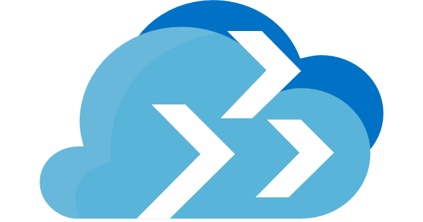


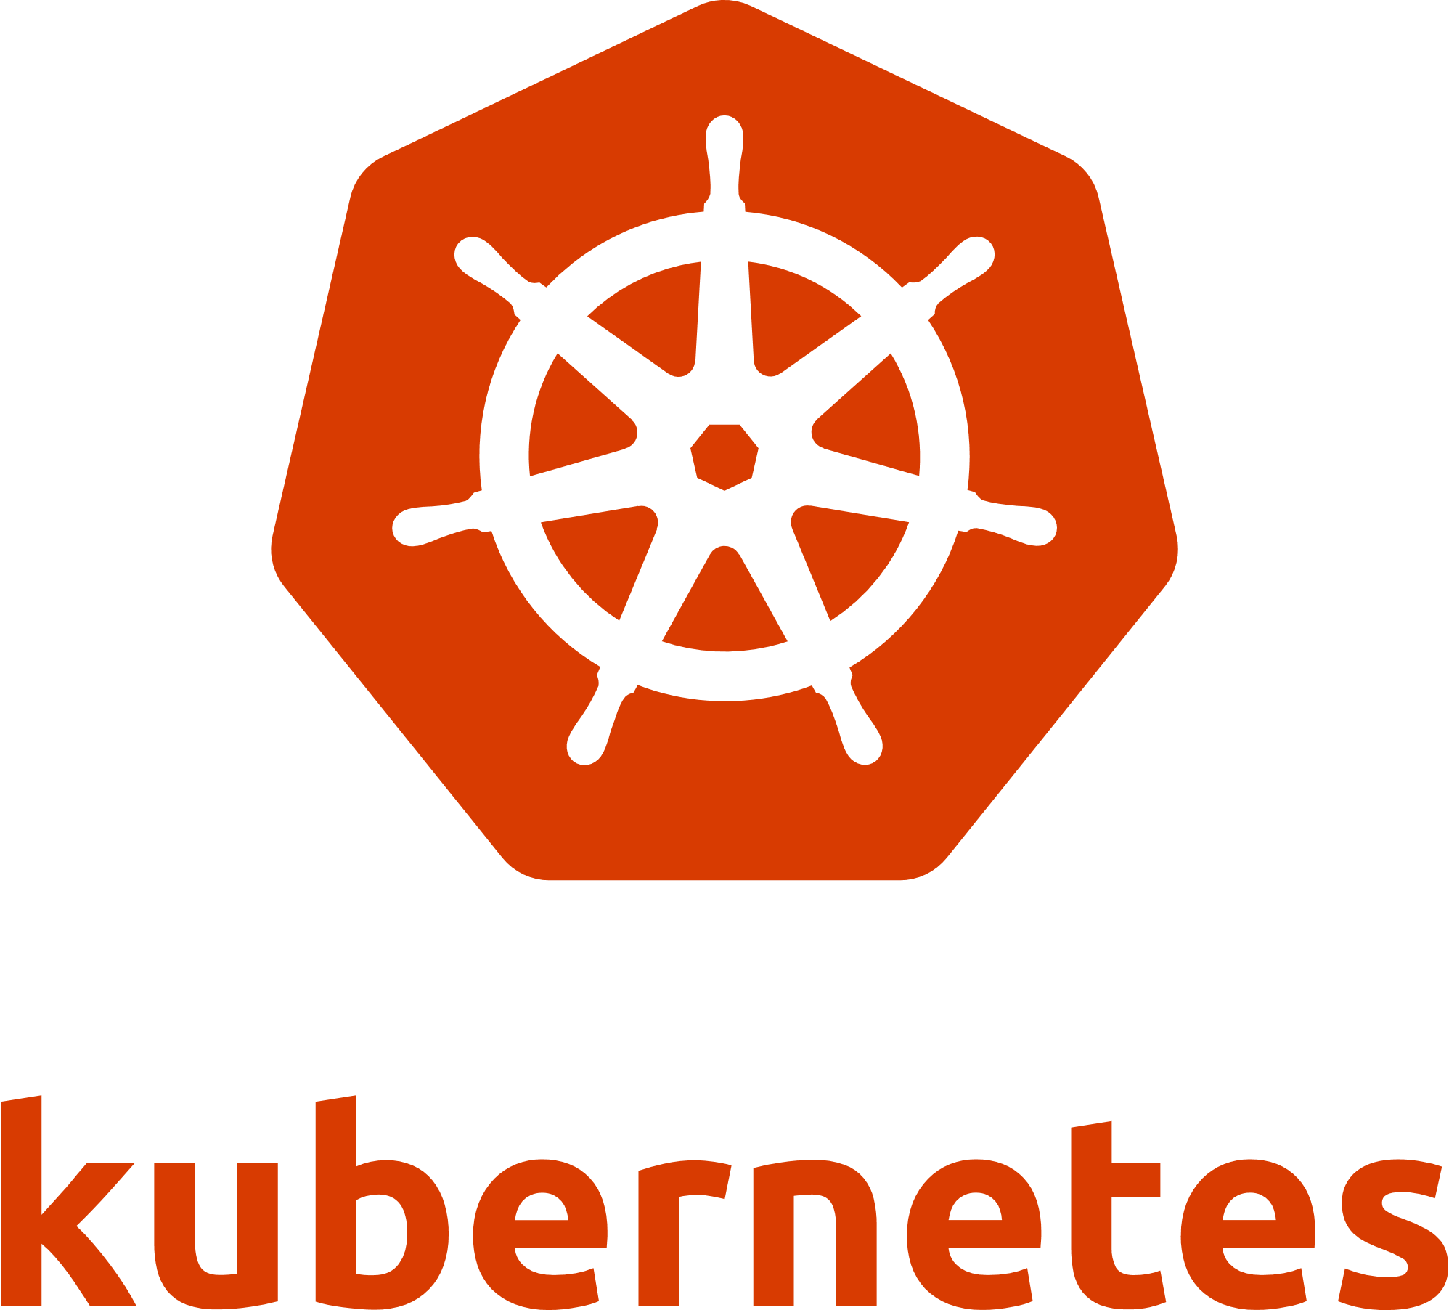



Azure capabilities across apps, data, and infrastructure
Azure Migrate
Java and Tomcat support in Azure app service
Azure Database for PostgreSQL, MySQL
My
Azure Site Recovery
Kubernetes on app service
Azure SQL database managed instance
Azure Database Migration Service
Red Hat Enterprise
Linux support
Cassandra/MongoDB on Azure Cosmos DB
Notes:
The story is very complete now across the board
Great migration tools available for free

Slide 8
Azure migration tools adoption over the last year
450K+ VMs
325K+ VMs
41K+ databases
Discovered by Azure Migrate
Assessed by Azure Migrate
Migrated by Azure Database Migration Service
Notes:
Tools have been out for about a year (9-12 months dating September 2018).
Database migration service is very new

Slide 9

















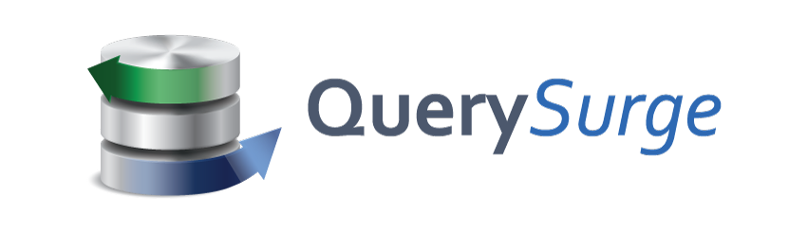
Choice of tools for every stage and every requirement
Goal is successful Azure migration: Pick the right tool for the job
Assess
Migrate
Optimize
Secure & Manage
Azure Migrate
Azure Site Recovery (ASR)
Azure Cost Management
Azure Security & Management
(e.g., Blueprint, Security Center, Backup, Monitor)
Data Migration Assistant (DMA)
Azure Database Migration Service
SQL Server Migration Assistant (SSMA)
Azure Data Box
We embrace ISV solutions
Notes:
By end of the year, many of these partner solutions will be integrated in the portal.
You won’t have to look for these tools, we will make it easy to find them.

Slide 10
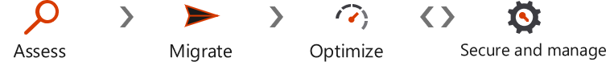
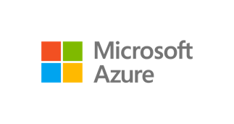


Migrate databases using Azure Database Migration Service
Migrate
On-premises
SQL Server 2005 - 2017
My
Assessment
SSMA & DMA
Azure Database Migration Service
Cosmos DB
Seamless, end to end solution | Near-zero downtime | Migrate at-scale from multiple sources
Notes:
For a full list of migration scenarios (Preview and GA)
https://docs.microsoft.com/en-us/azure/dms/resource-scenario-status

Slide 11
Azure Database Migration Service: Offline (one-time sync) migration scenarios
Migrate
Target | Source | Support | Status
Azure SQL DB | SQL Server | ✔ | GA
 | RDS SQL
 | Oracle
Azure SQL DB MI | SQL Server | ✔ | GA
 | RDS SQL
 | Oracle
Azure SQL VM | SQL Server | ✔ | GA
 | Oracle
Azure Cosmos DB | MongoDB | ✔ | GA
Azure DB for MySQL | MySQL
 | RDS MySQL
Azure DB for PostgreSQL | PostgreSQL
 | RDS PostgreSQL
Notes:
https://docs.microsoft.com/en-us/azure/dms/resource-scenario-status

Slide 12
Azure Database Migration Service: Online (continuous sync) migration scenarios
Migrate
Target | Source | Support | Status
Azure SQL DB | SQL Server | ✔ | GA
 | RDS SQL | ✔ | GA
 | Oracle
Azure SQL DB MI | SQL Server | ✔ | GA
 | RDS SQL | ✔ | GA
 | Oracle | ✔ | Private preview
Azure SQL VM | SQL Server
 | Oracle
Azure Cosmos DB | MongoDB | ✔ | GA
Azure DB for MySQL | MySQL | ✔ | GA
 | RDS MySQL | ✔ | GA
Azure DB for PostgreSQL | PostgreSQL | ✔ | GA
 | RDS PostgreSQL | ✔ | GA
 | Oracle | ✔ | Private preview
Notes:
https://docs.microsoft.com/en-us/azure/dms/resource-scenario-status

Slide 13
Azure SQL Database Managed Instance ‒ GA (General Purpose)
Migrate
Migrate SQL Server to fully managed SQL in Azure
Fully compatible with SQL Server
Built-in HA, Failover, Geo-DR, Intelligence
NEW: Azure SQL Database Hyperscale
SQL
New, highly scalable service tier with built in intelligence
Migrate multi-TB databases to Azure
Auto-scale up to 100 TB per database
Notes:
Managed instance is GA too. We’ll talk more about it later.
Fully managed.
Move the whole workload to Azure.
Very popular.
Scaling.
Hyperscale: Preview, for huge storage, no worries about the database size.
Note: Hyperscale is GA for Single database and in preview for managed instances

Slide 14

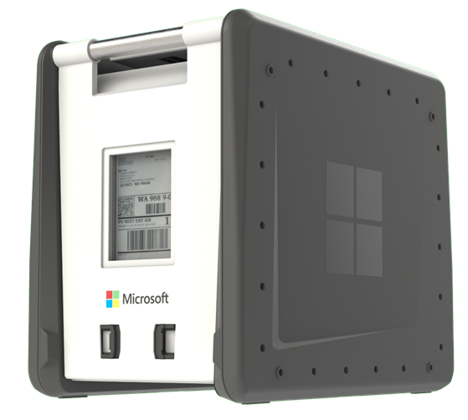
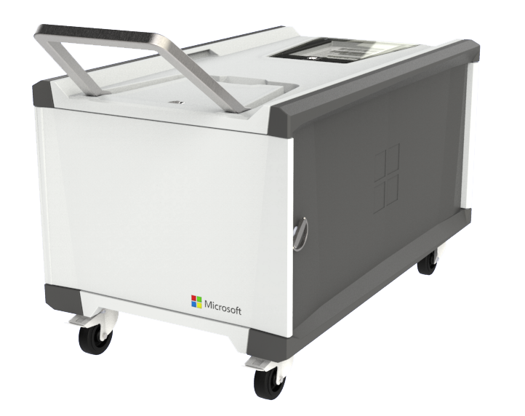
Azure Data Box family provides additional data migration options
Migrate
Gateway
100 TB
Migrate large amounts of data quickly and securely
Heavy (1 PB)
Preview
Gateway
100 TB
Heavy (1PB)
General Availability
Preview
Notes:
Data box: Small, Medium (100TB) and Heavy (1PB).
Move data into the datacenter without relying on wires.
We handle the shipping to you and then back to our facilities.

Slide 15


Tailwind Traders acquires Northwind
REDMOND, WA December 06, 2018 Tailwind Traders, Inc announced that it has agreed to acquire Northwind Traders, the venerable "old guard" international foods company, in an effort to bolster its virtual hardware offerings with some international culinary flare. Tailwind agreed to acquire Northwind for an undisclosed sum and will assume control of all of Northwind's virtual assets, including the company's flagship product: Aniseed Syrup
"This is a profoundly wonderful development for all involved, and will help to bring our food products to a whole new sector of the market" stated Nancy Daviolo, Executive Vice President of Operations. "We couldn't be happier with the arrangement". The recently-promoted Daviolo will join the Tailwind executive team along with two of her close associates, Margaret Peacock and Michael Suyama. Daviolo took over Northwind's sales operations in 2012 after Andrew Fuller was forced out of the company as a result of charges of fraud and embezzlement of more than 5,000 cases of Grandma's Boysenberry Spread.
https://github.com/Azure-Samples/tailwind-traders

Slide 16
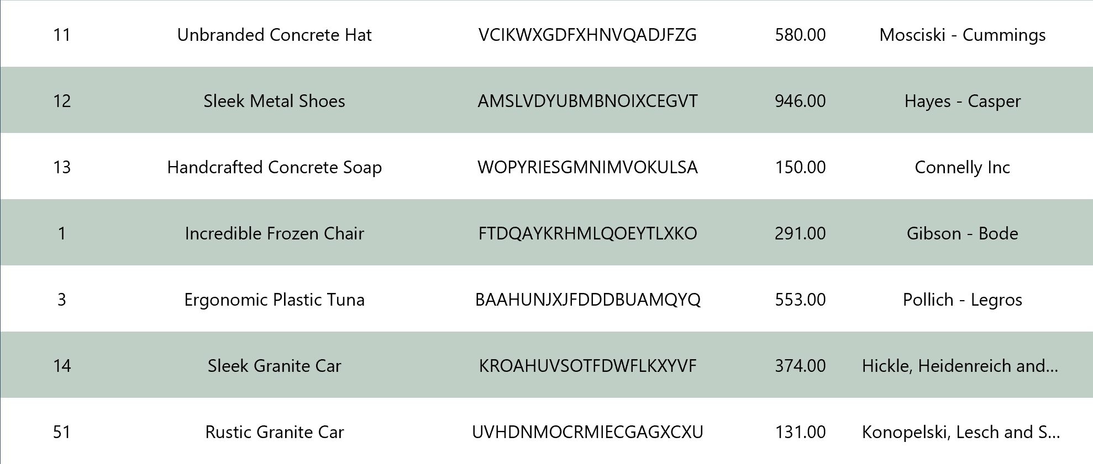
A rich catalog…

Slide 17






Architecture before the move
STATIC
ASP.NET
AZURE
ON PREMISE
SQL SERVER 2012
MONGODB

Slide 18


Architecture after the move
STATIC
ASP.NET
AZURE
ON PREMISE
SQL MANAGED INSTANCE
COSMODB MONGO API
SQL SERVER 2012
MONGODB

Slide 19
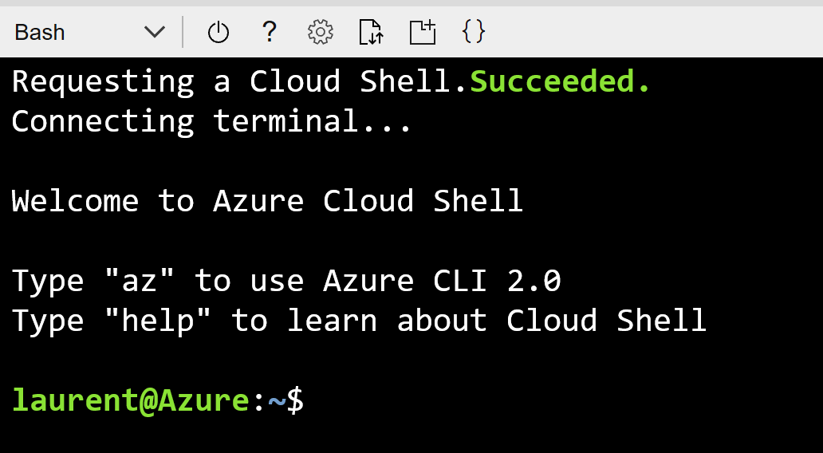
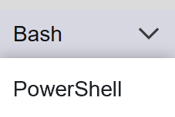
Cloud Shell

Slide 20
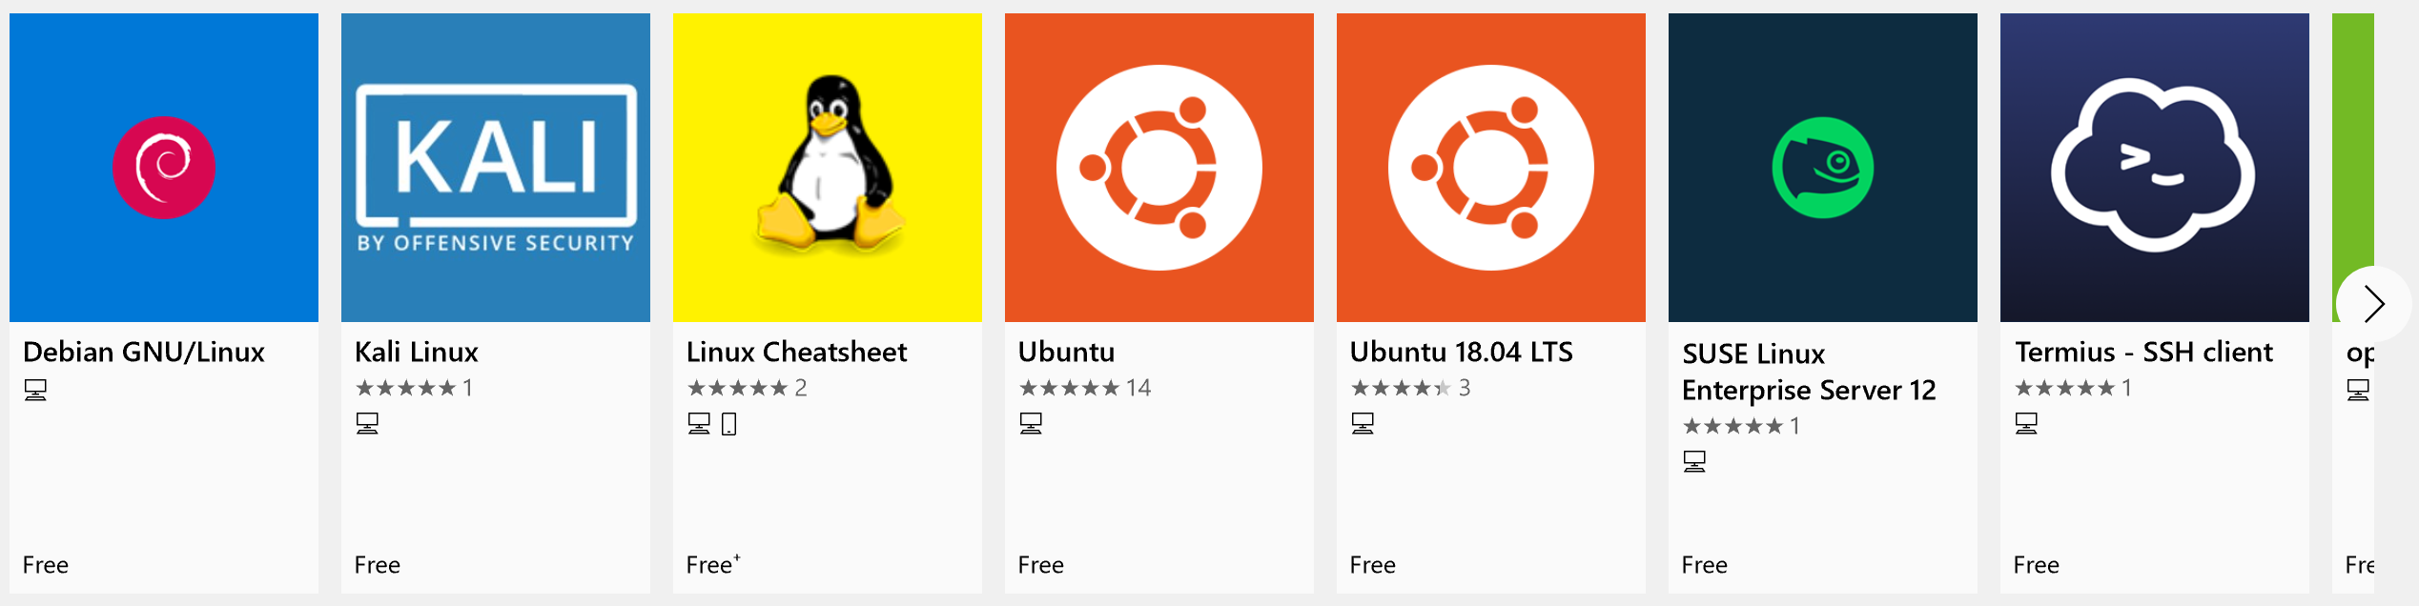
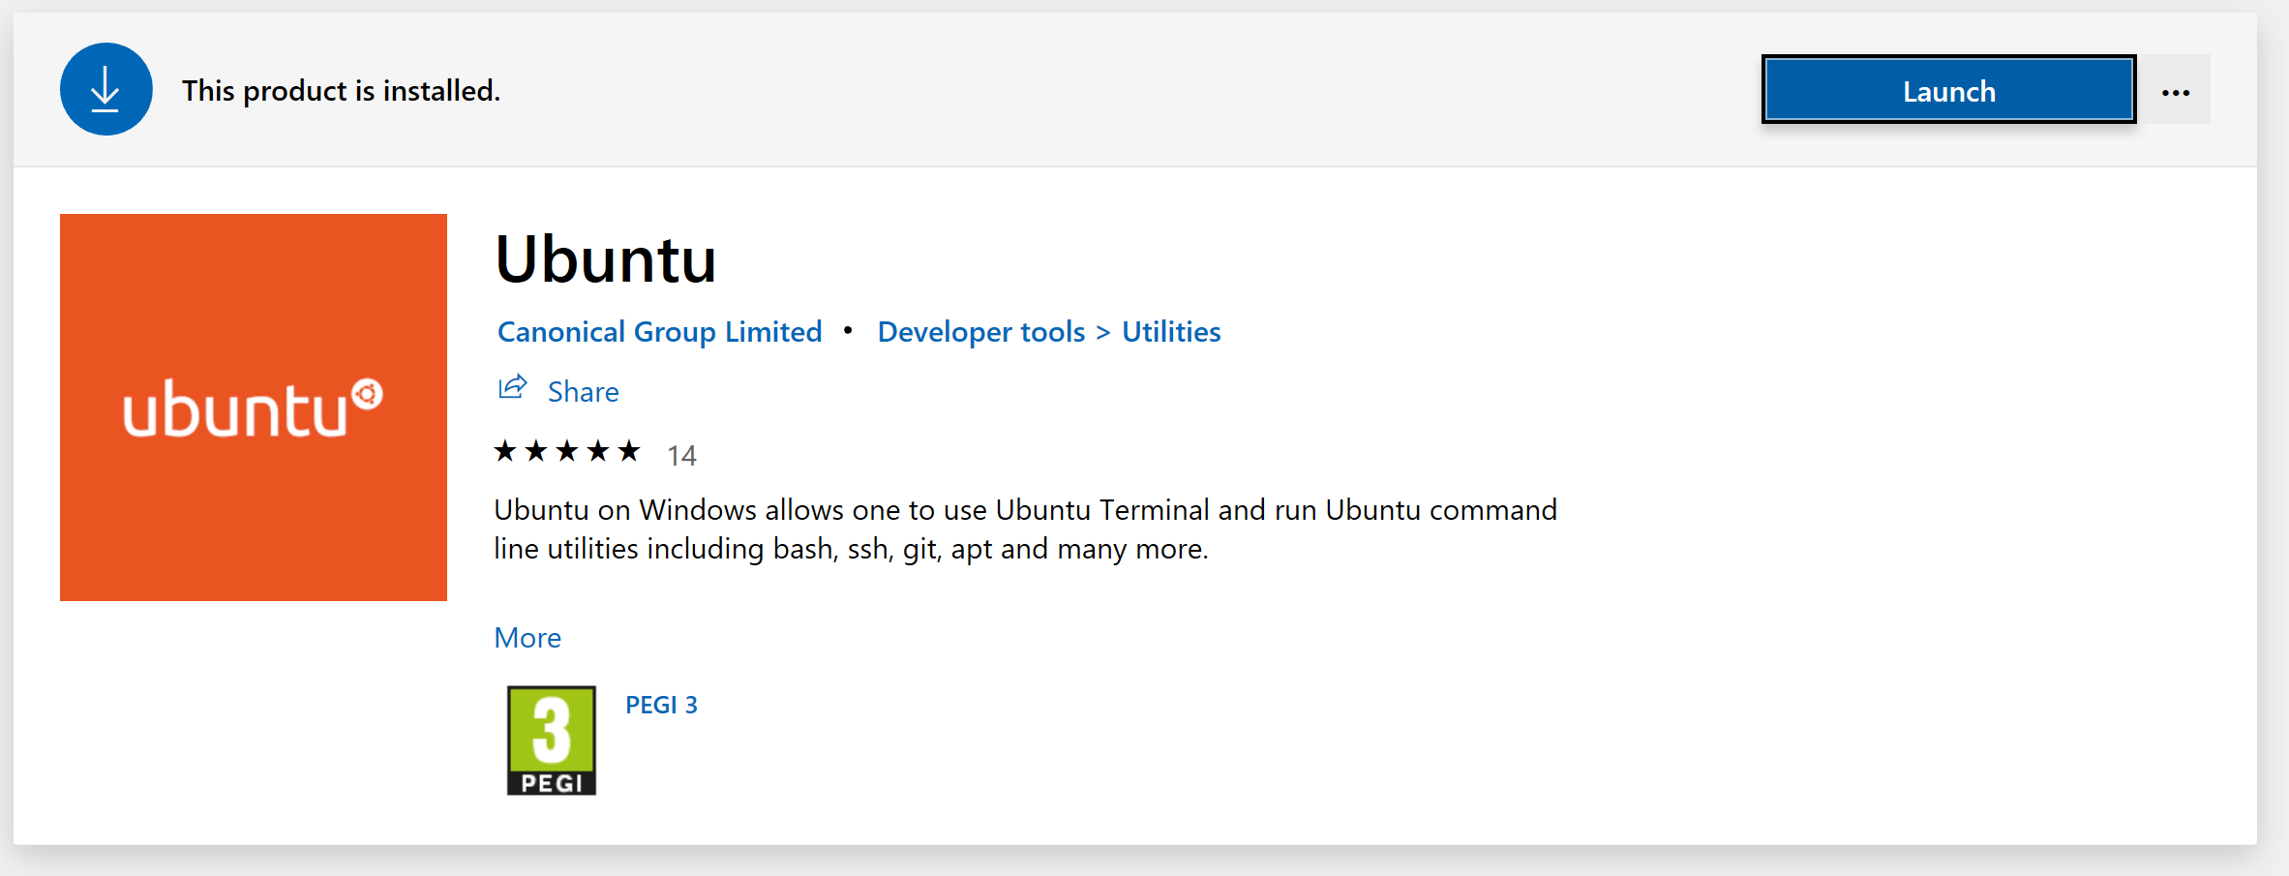
Windows Subsystem for Linux (WSL)

Slide 21

Demo
Creating the CosmosDB instance with CloudShell

Slide 22

Azure Cosmos DB
Globally distributed database service

Slide 23


Azure Cosmos DB APIs
MongoDB
SQL
Table storage
Gremlin Graph
Spark
Cassandra
Now GA

Slide 24





SQL
mongoDB
Azure Cosmos DB
… more coming soon
Key-Value
Column-family
Documents
Graph
Global distribution
Elastic scale out
Guaranteed low latency
Five consistency models
Comprehensive SLAs
A globally-distributed, multi-model database service
Notes:
It is a database born in cloud – from the inception - fundamental design goals was Automatic Global distribution – Limitless scale – Low Latency – High throughput – and Well defined consistency model - SLA
So we Built the platform with these Core Capability.
As a developer you also want the flexibility. With Azure Cosmos DB, you don’t have to model the data in JUST one way. You can model the data the way you want.
Key-Value, Column, Documents or Graph.
That’s why say Cosmos DB is a multi-model database.
What about how you access data. What about frameworks, API and tools that you are familiar with. We do not want you yo learn a new API. We make every API and language a first-c;ass citizen of Azure Cosmos DB. If you are familiar with DocumentDB SQL or DocumentDB JS, we continue to support and innovate on that front. If you are a MongoDB developer, we have support for MongoDB wire protocol. Azure Cosmos DB can be your globally distributed, secure, fully managed Mongo Instance. Today, we announced preview of Azure Tables API and Gremlin for graph capabilities. We have more in the works and our roadmap is to extend this over the coming months to include Hbase, Cassandra and other OSS API.

Slide 25
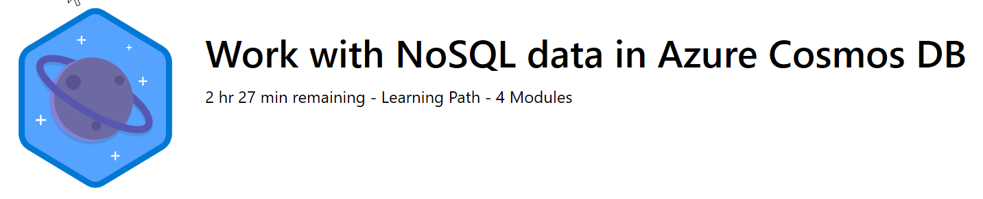
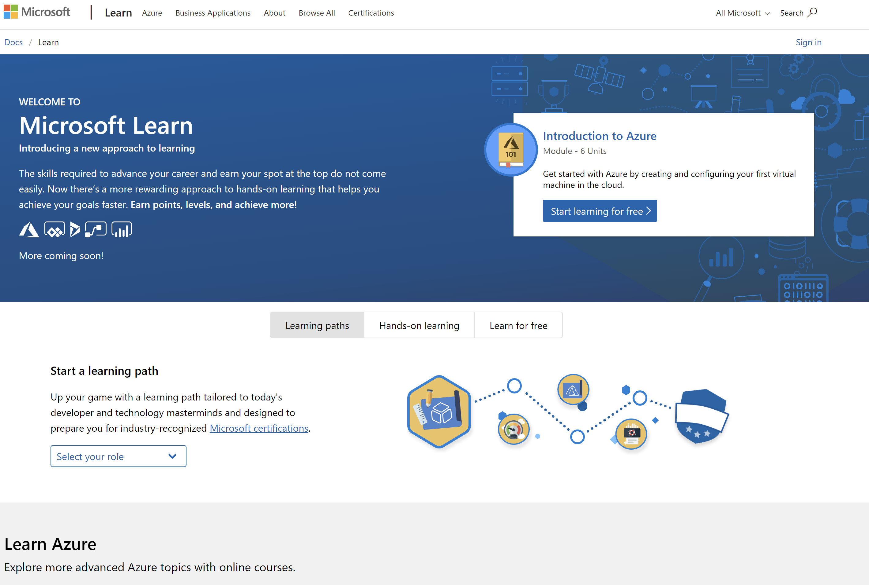
/Learn alert
Expository text about the learning path goes here. This text box wraps.
http://gslb.ch/247s-MSIgniteTheTour

Slide 26
Mongo APIs: Dump
ssh '[USER]@'[IPADDRESS]
mongodump --collection [COLLECTION] --db [DATABASE]

Slide 27
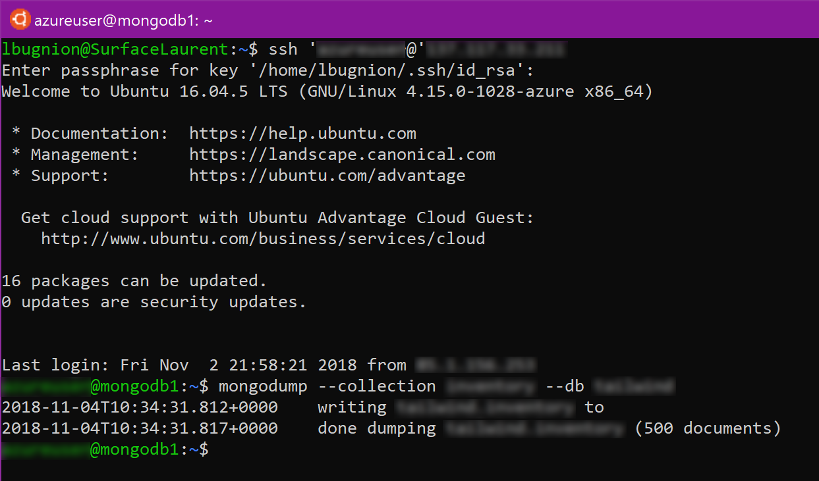
Mongo APIs: Dump

Slide 28
Mongo APIs: Restore
cd dump
cd [DATABASENAME]
mongorestore --host [HOSTNAME]:10255 -u [USER] -p [PASSWORD] --ssl --sslAllowInvalidCertificates [BSONFILE].bson --numInsertionWorkersPerCollection 4 --batchSize 24 --db [DATABASENAME] --collection [COLLECTIONNAME]

Slide 29
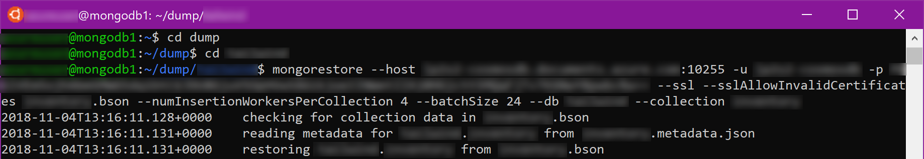
Mongo APIs: Restore

Slide 30
Demo
Migrating the MongoDB to CosmosDB

Slide 31
How to easily migrate and get benefits of cloud?
Migrate*
Rehost
(lift and shift)
Refactor
Assess
Optimize
Rearchitect
Rebuild
Notes:
Managed instance requires no or very little changes to you DB

Slide 32

Demo
Assessing the Database before migration with the Microsoft Data Migration Assistant
Migrating SQL Server to SQL Managed Instance
(Part 1)
Notes:
Intro: Everything starts with assessment
What kind of application they have
What goals do they want to achieve by moving in the cloud
What destination in the cloud is most compatible or best according to their goals
Run the Microsoft Data Migration Assistant
Create a new project:
Assessment
Project name (random)
Source: SQL Server
Target: Azure SQL Database Managed Instance
Select source:
Server name: sql6c4b8e.eastus.cloudapp.azure.com
SQL Authentication
Username: username
Password: d04f69d38b163f60A1!
SQL Migration:
Show the SQL Managed instance in the portal
Show the DMS page in the portal
Show how to create the project
Explain online (preview)
Create a migration activity
Start it
Show the progress dialog

Slide 33
SQL Managed Instance: Key takeaways
Managed Instance is Generally Available from October 1!!!
Managed Instance is enterprise-ready
With Managed Instance, you easily migrate SQL Server to cloud, and get all the benefits of a fully-managed service
Notes:
SQL Managed instance was designed to allow best and easiest migration from on premise SQL server into the cloud.
Two years of work.
99,99% SLA, disaster recovery, intelligent performance and security insights.
Linked-Servers, Cross-Database Queries, CLRs and SQL Agent

Slide 34
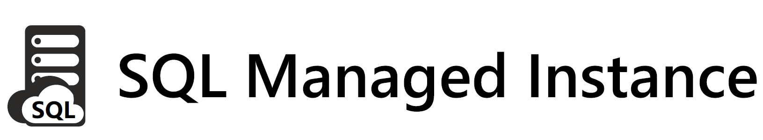
How to easily migrate and get benefits of cloud?
Migrate*
Rehost
(lift and shift)
Enables rehosting or light refactoring for most apps
Enables optimization during or post migration (fully managed service)
Refactor
Assess
Optimize
Rearchitect
Eliminates the need
to rearchitect or
rebuild your apps
IaaS (virtual machines) fall short here
Rebuild
Notes:
Managed instance requires no or very little changes to your DB.
Optimization only possible in managed DBs, difficult in IaaS (VMs)

Slide 35
What is SQL Database Managed Instance?
SQL Database (PaaS)
New deployment option enabling friction-free migration of
SQL Server workloads to
a fully-managed service
Managed Instance
Single database
Elastic Pool
Fully-managed service
SQL Server compatibility
Full isolation and security
New purchasing options
Built on the same infrastructure as SQL Database
Provides the same benefits (PaaS)
Fully-fledged SQL instance with nearly 100% compat with on-premise
Contained within your VNet
Private IP addresses
Express Route / VPN connectivity
Transparent
Frictionless
Competitive
Notes:
New flavor of SQL database.
Particularly good for migration of existing SQL databases.
All advantages of PaaS
Automatic backups, availability etc all the same, same infrastructure
Scaling
Where is it unique?
SQL server compatibility (nearly 100%)
Full isolation and security
Opening up more things
New purchasing options:
Introduced for SQL Managed instance
Rolled out to other flavors of the service
You will know exactly what resources are allocated
Able to scale up and down
Protects your license investments, you can get large discounts
Competitive with competition

Slide 36
Put your DBs on autopilot and focus on your business…
Tired of managing hardware, software & business continuity?
You can stop doing it, Managed Instance has it built-in
 | Compute & storage provisioned on demand Fast & online scaling Full stack updates and patches
 | Backups with health checks Point-in-time restore (configurable retention *)
 | 99.99% availability with automatic failover Disaster recovery with single geo secondary (multiple*)
* - features coming soon
Notes:
Scaling
Patching
Backup, retention configurable to any time.
(currently fixed, soon configurable)
Geoactive replication
Now single geo replication. Soon multiple. Through API call.

Slide 37
Put your DBs on autopilot and focus on your business…
Is it hard to secure data and ensure standards compliance?
Is it hard to monitor and tune all your workloads?
It’s much easier with the Managed Instance
 | Compliance with all major industry standards Threat detection with automatic alerting
 | Intelligent query processing Automatic performance tuning*
 | Monitoring at scale with Intelligent Insights Data discovery and classification* Vulnerability assessment
* - features coming soon
Notes:
Intelligent database as a service
Threat detection: Looking for threats during the work, eg SQL injection
Intelligent query: Can start a query and while it is processed, figure out to optimize the join on the fly, etc
Automatic perf tuning goes even further: I could really use an index on this table, this column and overall your workload will run faster.
Built into SQL database, coming soon in Managed instance.
Also checking things like performance, GDPR compliance etc an alerts you.

Slide 38
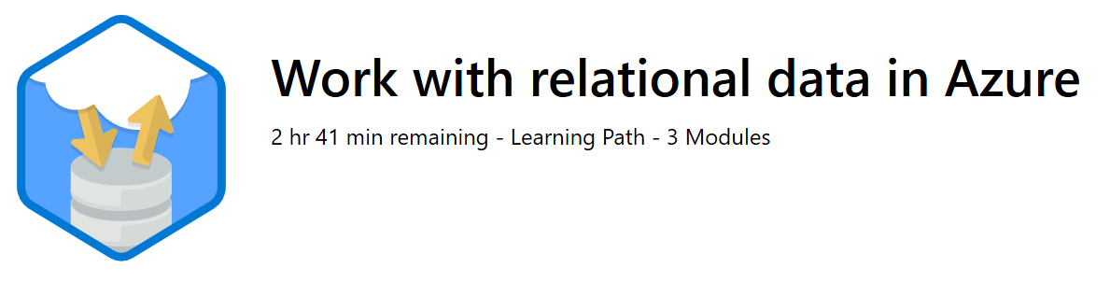
/Learn alert
Expository text about the learning path goes here. This text box wraps.
http://gslb.ch/249s-MSIgniteTheTour

Slide 39
Demo
Migrating SQL Server to SQL Managed Instance
(Part 2)

Slide 40
Migrate
Azure Container Instances
Refactor your apps using Azure container technologies and partners
Azure Kubernetes Service (AKS)
Azure Service Fabric
Azure App Service

Slide 41

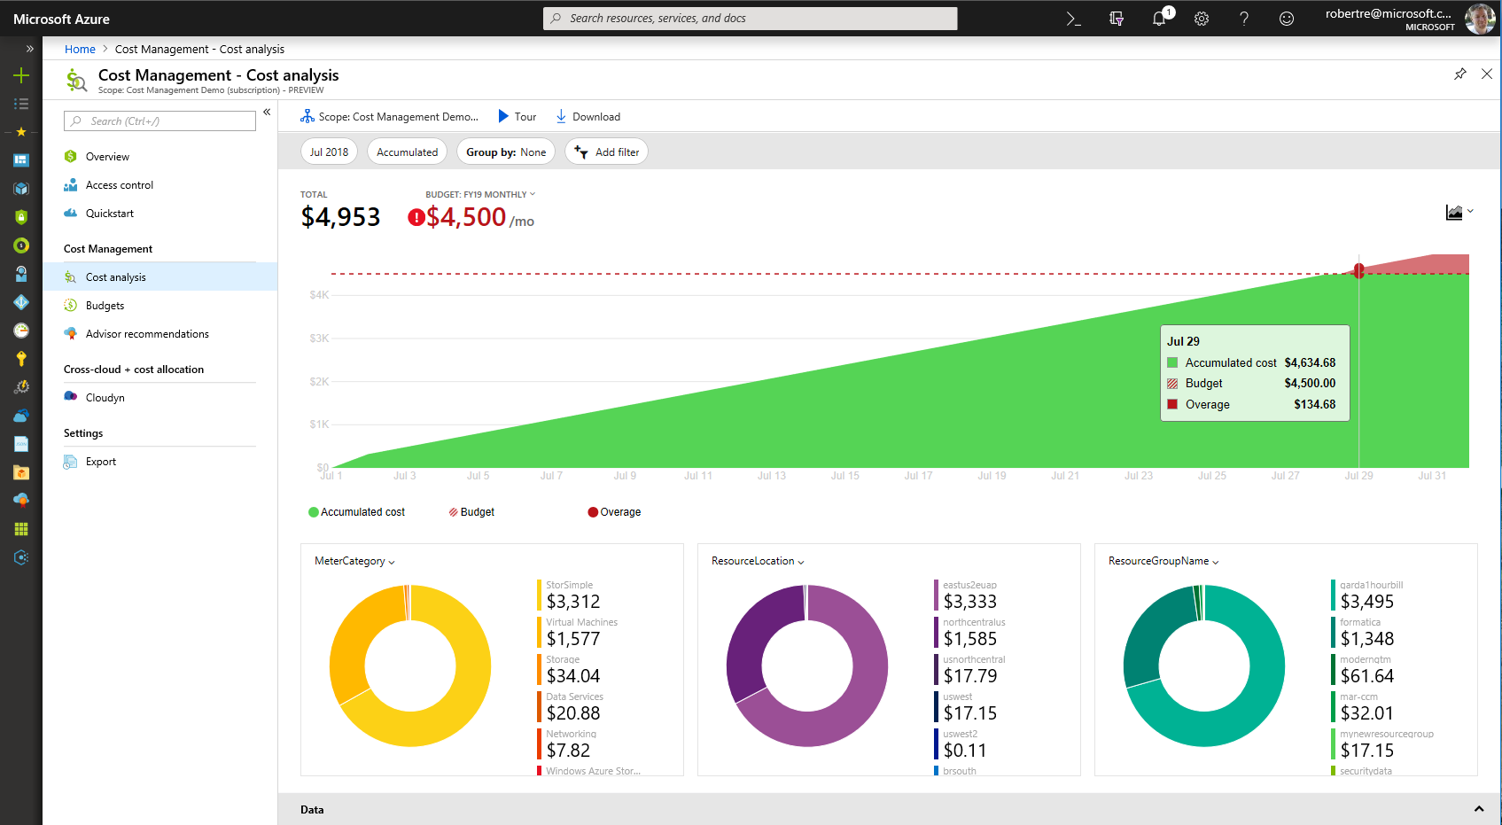
Continuously optimize migrated resources
Optimize
Azure Cost Management
Unified experience to optimize cloud spends
Built-in best practice recommendations (e.g., turn off idle VMs)
Use Azure Hybrid Benefit and Azure Reserved Instances during or after migration
Modernize for longer term value
Notes:
Inside Azure we just shipped Azure Cost Management.
Unified experience to think about cloud spending.
Create budgets etc.

Slide 42
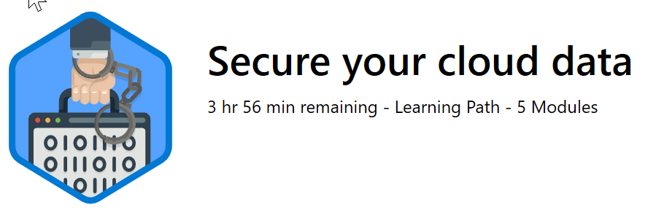
/Learn alert
Expository text about the learning path goes here. This text box wraps.
http://gslb.ch/248s-MSIgniteTheTour

Slide 43
Resources

Slide 44
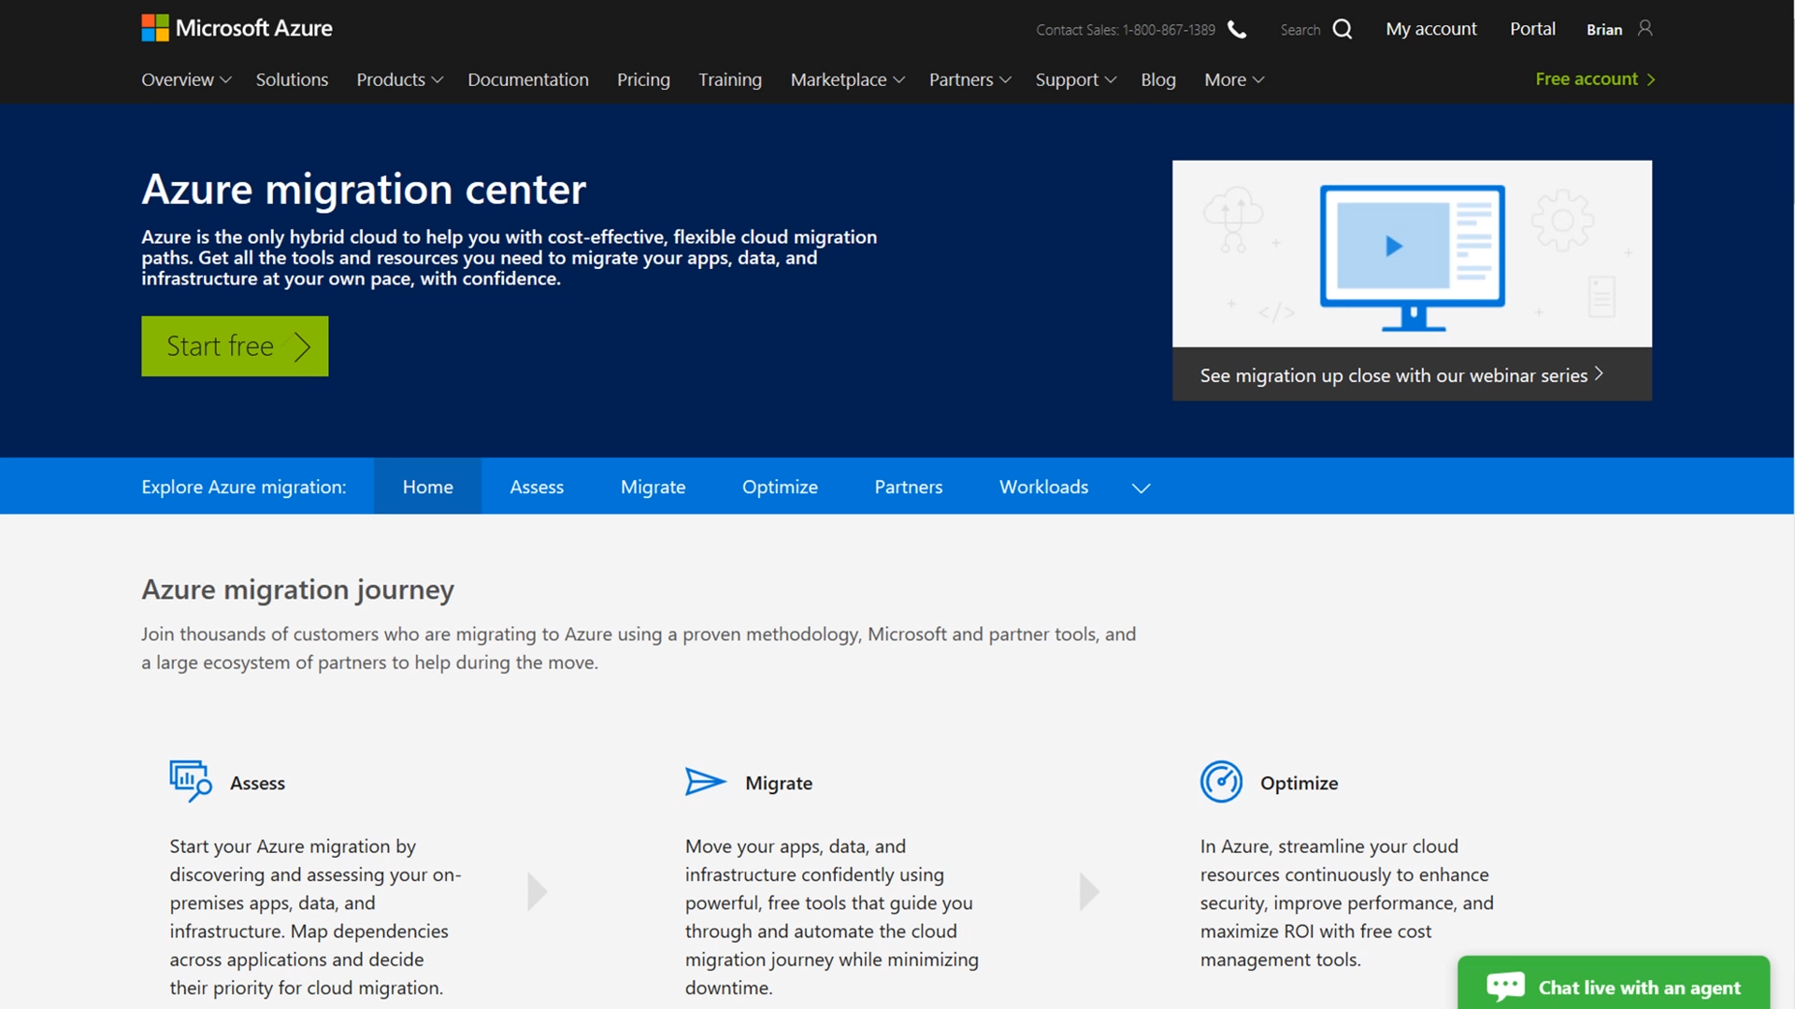
Azure.com/Migration All things migration
Guidance
Tools
Partners
Migration journey and strategies
Right tools for the job
Migration experts

Slide 45
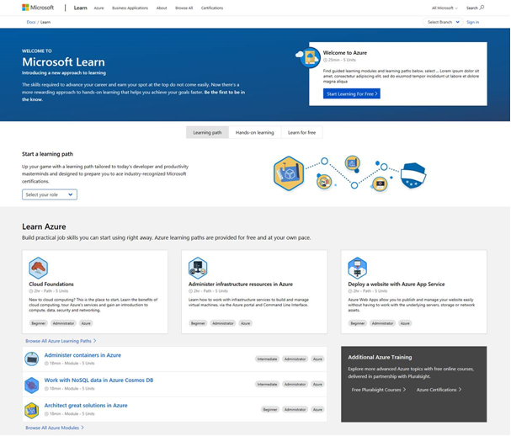
Keep up to date on your Azure skills as you migrate
Announcing free migration course Assessing and Planning Azure Migration
Microsoft.com/Learn
Build skills quickly
Measure Azure skill proficiency
Role based certification & training

Slide 46
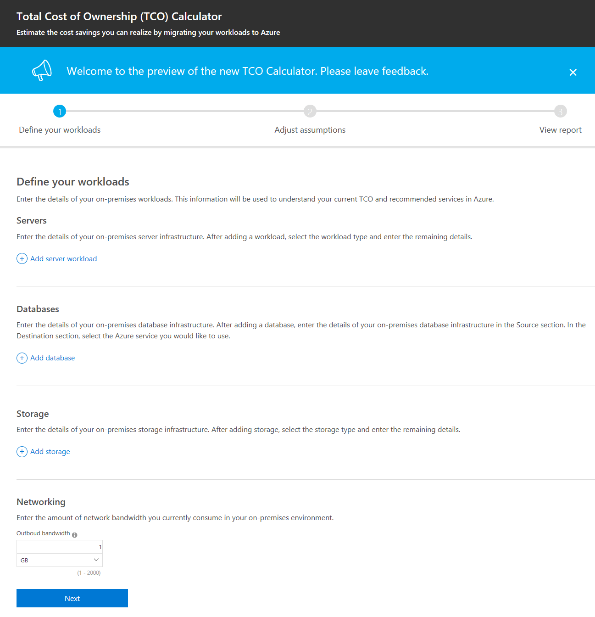
Build your case: Azure TCO calculator
Azure.com/tco
Notes:
Simplified front end, Energy cost, end of support cost, Azure Hybrid benefits, Reserved instances.
Very good start on business case.

Slide 47
Get help: FastTrack for Azure can help you migrate quickly and confidently
Benefits
FastTrack for Azure
Direct assistance from Azure engineers and program managers
Use proven practices and tools from real customer experiences
Accelerated deployment to full production of Azure solutions
Quickly Build Solutions
Achieve Business Objectives
Successfully Deploy to Production
Engagement phases
Discovery: Validate project scope, vision, requirements and assess architectural needs
Solution Enablement: Guidance on solution architecture design using proven practices and design principles
Deployment: Support in-house customer and/or partner led deployment of Azure solution
Continuous Partnership: Provide periodic check-ins and address additional workloads and deployment needs
Please visit Azure.com/FastTrack for more information
Notes:
Great tool to build confidence and start the migration journey.

Slide 48




















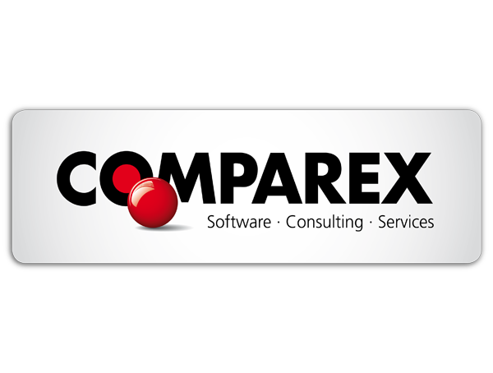
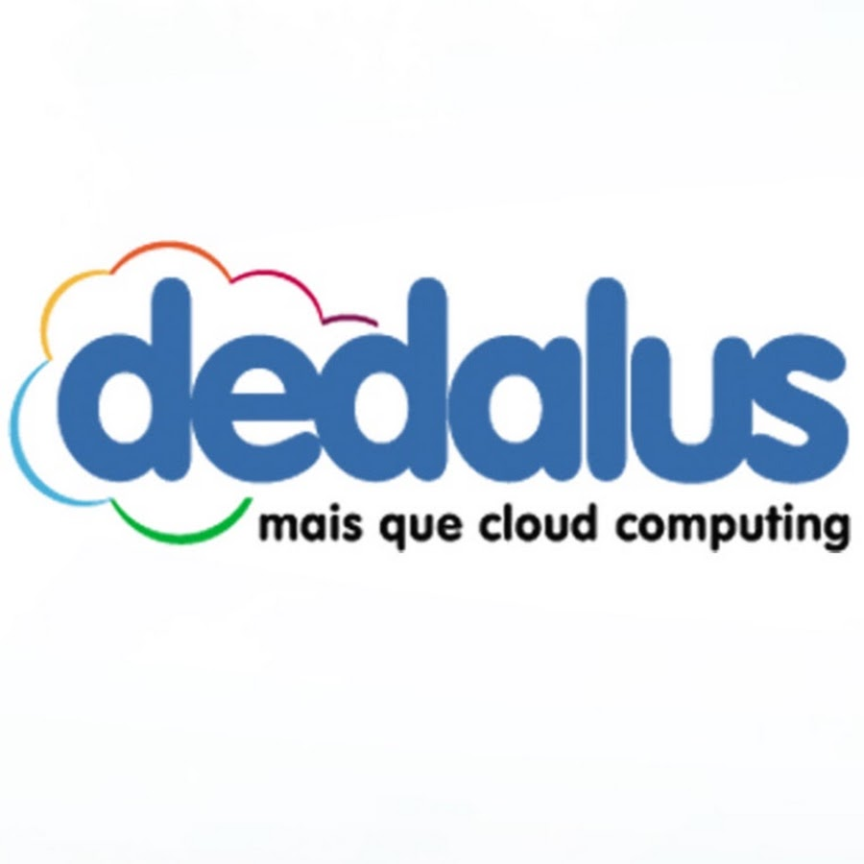







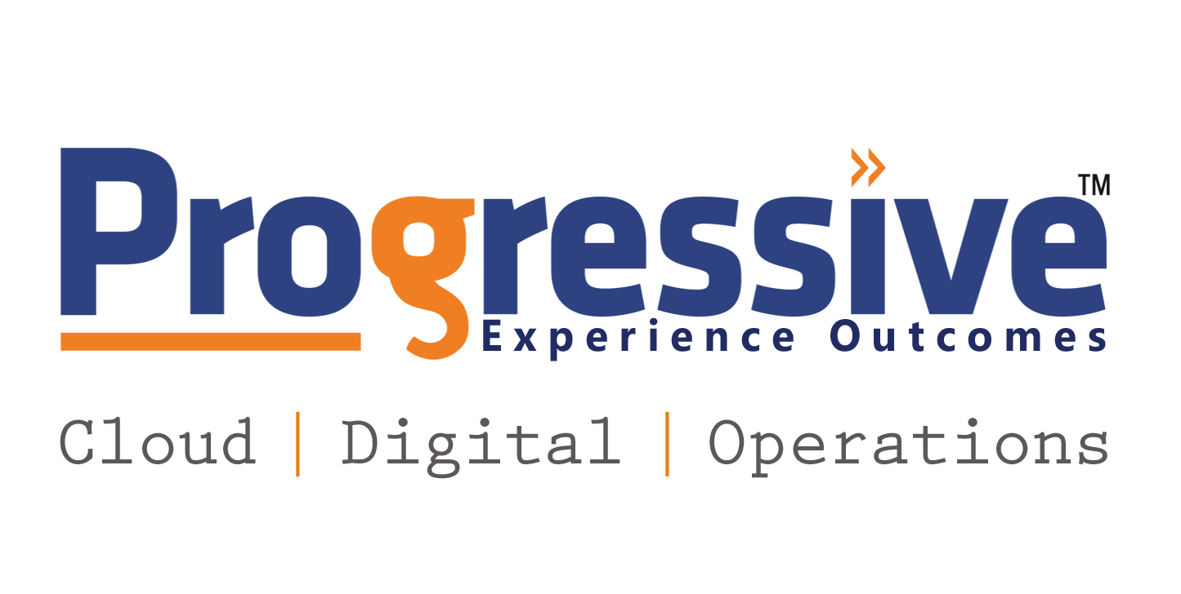





Get help: skilled migration partners
Click here to search for and Azure expert MSP in your region
Notes:
Some partners worldwide, some more local based on geographical needs.

Slide 49
Get started today
1
2
3
Assess migration cost savings
Learn more, find a
migration partner
Start your migration
project
Azure.com/TCO
Azure.com/Migration
Aka.ms/AzureExpertMSP
Azure.com/MigrateNow
Notes:
In summary…

